Slide 1

Research Overview & Related Article
A. Osamu Katagiri Tanaka A01212611itesm.mx
April 04, 2019

Slide 2
Agenda
My Thesis Overview : <5min
Related Article : ~20min
Q&A : ~10min

Slide 3
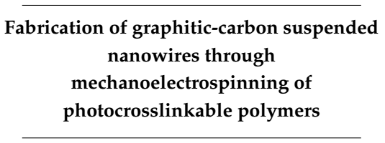
Thesis Overview
Study the practice and feasibility of a new fabrication process to achieve mass scale manufacturing of carbon nano-wires in an inexpensive, continuous, simple and reproducible manner

Slide 4
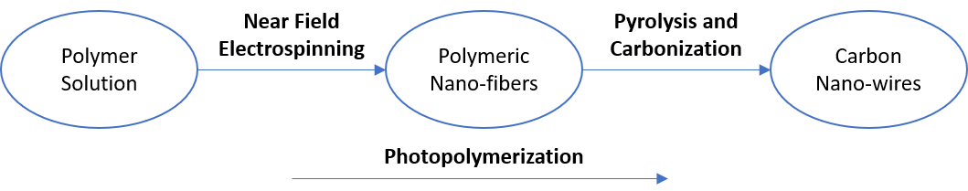
Thesis Overview
Design polymer solutions that can be electrospun by NFES, photopolymerized, and then pyrolyzed into carbon nano-wires.

Slide 5
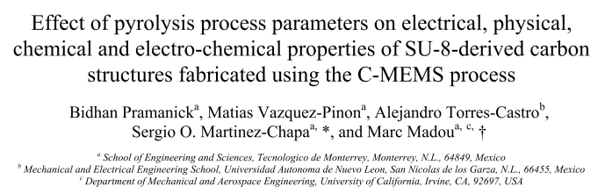
Related Article
Pramanick, B., Vazquez-Pinon, M., Torres-Castro, A., & Martinez-Chapaa, S. O. (2018). Effect of pyrolysis process parameters on electrical, physical, chemical and electro-chemical properties of SU-8-derived carbon structures fabricated using the C-MEMS process. Materials Today: Proceedings, 5(3), 9669–9682. https://doi.org/10.1016/J.MATPR.2017.10.153

Slide 6
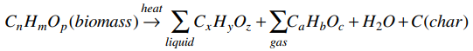
Pyrolysis
Is the chemical decomposition of any organic polymer by heating in an oxygen-free environment
This degradation technique can lead to the formation condensable gases and carbonized materials
Basu, P. (2018). Biomass Gasification, Pyrolysis and Torrefaction - Practical Design and Theory (3rd Edition). Elsevier. Retrieved from https://app.knovel.com/hotlink/pdf/id:kt011PGVNJ/biomass-gasification/biomass-ga-historical

Slide 7

Pyrolysis parameters that were investigated
Maximum Pyrolysis Temperature
Temperature Ramp Rate
Gas ($N_{2}$) flow rate
Pramanick, B., Vazquez-Pinon, M., Torres-Castro, A., & Martinez-Chapaa, S. O. (2018). Effect of pyrolysis process parameters on electrical, physical, chemical and electro-chemical properties of SU-8-derived carbon structures fabricated using the C-MEMS process. Materials Today: Proceedings, 5(3), 9669–9682. https://doi.org/10.1016/J.MATPR.2017.10.153

Slide 8
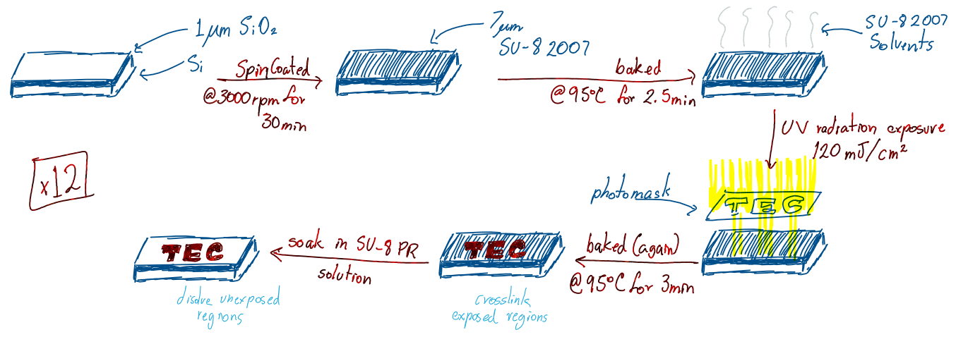
Experiment - Step 1: photolithography
Fabrication of SU-8 polymeric structures

Slide 9
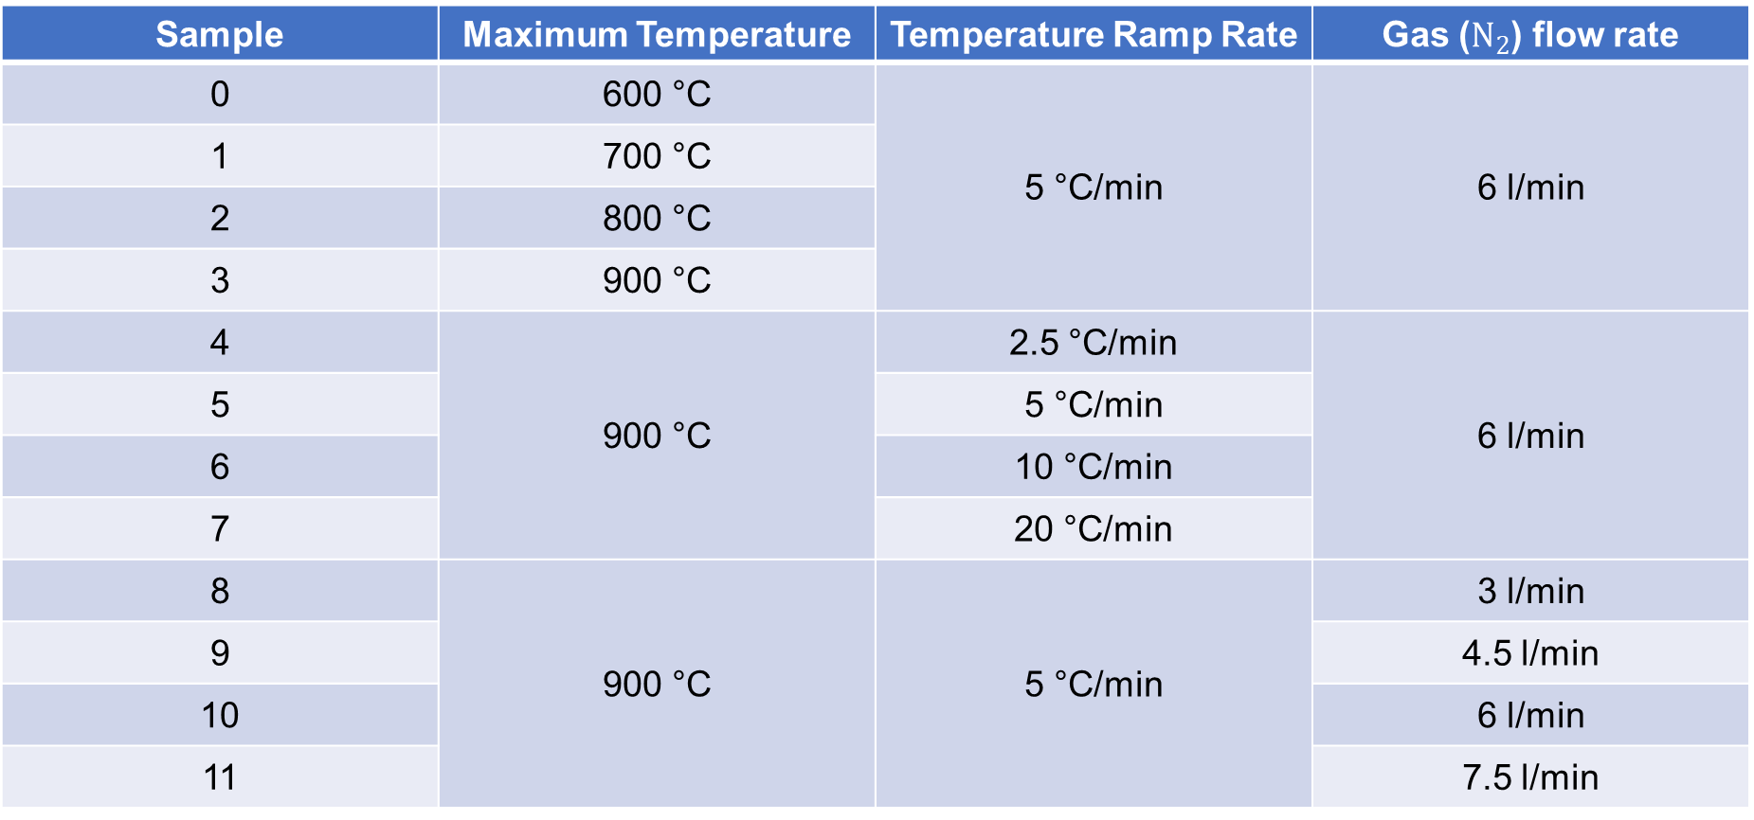
Experiment - Step 2: pyrolysis
Sample | Maximum Temperature | Temperature Ramp Rate | Gas ($N_{2}$) flow rate
0 | 600 °C | 5 °C/min | 6 l/min
1 | 700 °C
2 | 800 °C
3 | 900 °C
4 | 900 °C | 2.5 °C/min | 6 l/min
5 |  | 5 °C/min
6 |  | 10 °C/min
7 |  | 20 °C/min
8 | 900 °C | 5 °C/min | 3 l/min
9 |  |  | 4.5 l/min
10 |  |  | 6 l/min
11 |  |  | 7.5 l/min

Slide 10
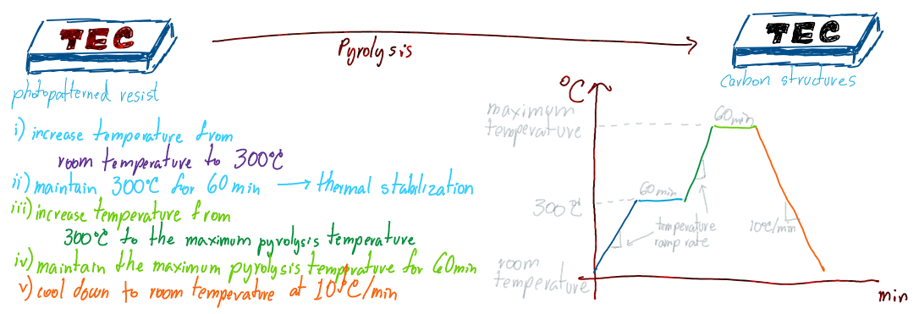
Experiment - Step 2: pyrolysis
Fabrication of carbon structures

Slide 11
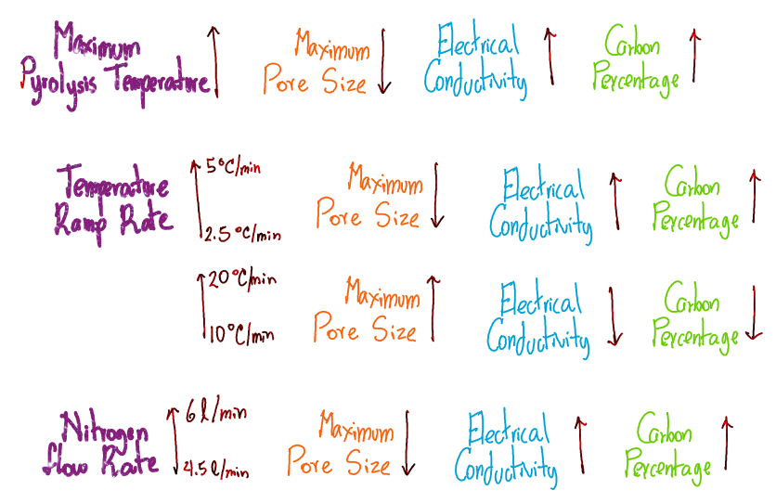
Results: the effect of …
Notes:
Effect of maximum pyrolysis temperature
As the maximum pyrolysis temperature increases, the maximum pore size of the material decreases.
The structure becomes more conductive with the increase of temperature, as the carbon percentage increases.
Effect of temperature ramp rate
As the temperature ramp rate increases from 2.5°C/min to 5°C/min, the maximum pore size of the material decreases.
As the temperature ramp rate increases from 10°C/min to 20°C/min, the maximum pore size of the material increases.
As the temperature ramp rate increases from 2.5°C/min to 5°C/min, the structure becomes more conductive.
As the temperature ramp rate increases from 10°C/min to 20°C/min, the structure becomes less conductive.
Effect of nitrogen flow rate
The maximum pore size decreases with the increase of nitrogen flow rate from 4.5l/min to 6l/min
@ 4.5l/min the inert environment is not well established -> the pore size is dependent on the incorporation of oxigen
The structure becomes more conductive with the increase of nitrogen flow rate.

Slide 12
Conclusions:
The best results were achieved with 900°C maximum temperature, 5°C/min temperature ramp rate, and 6l/min nitrogen flow rate
The temperature ramp rate can change the chemical reaction rate
The 3l/min-nitrogen-flow-rate sample was destroyed
Complete oxygen inerteness is to be ensured …
And it depends on the furnace volume

Slide 13

Q&A

Slide 14
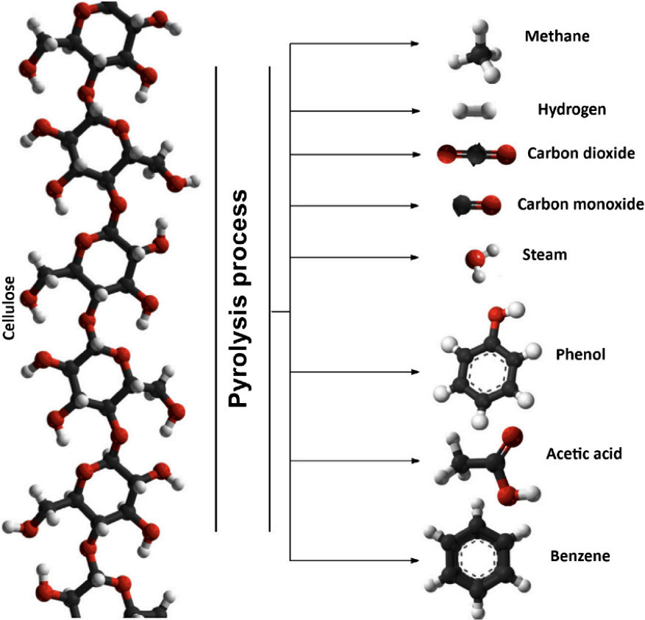
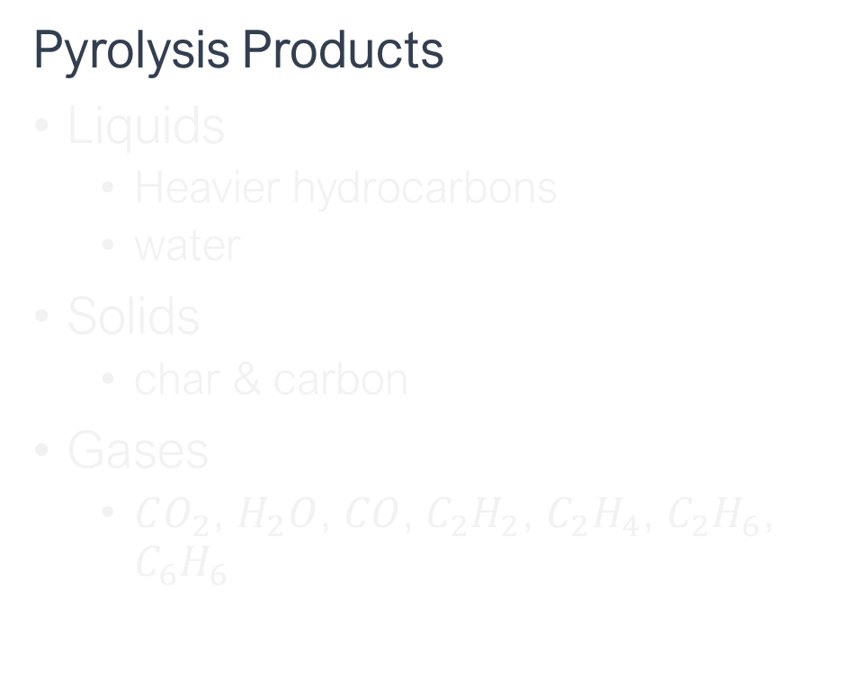
Decomposition of large hydrocarbon molecules into smaller ones during pyrolysis
Pyrolysis Products
Liquids
Heavier hydrocarbons
water
Solids
char & carbon
Gases
$CO_{2}$, $H_{2}O$, $CO$, $C_{2}H_{2}$, $C_{2}H_{4}$, $C_{2}H_{6}$, $C_{6}H_{6}$
Basu, P. (2018). Biomass Gasification, Pyrolysis and Torrefaction - Practical Design and Theory (3rd Edition). Elsevier. Retrieved from https://app.knovel.com/hotlink/pdf/id:kt011PGVNJ/biomass-gasification/biomass-ga-historical

Slide 15
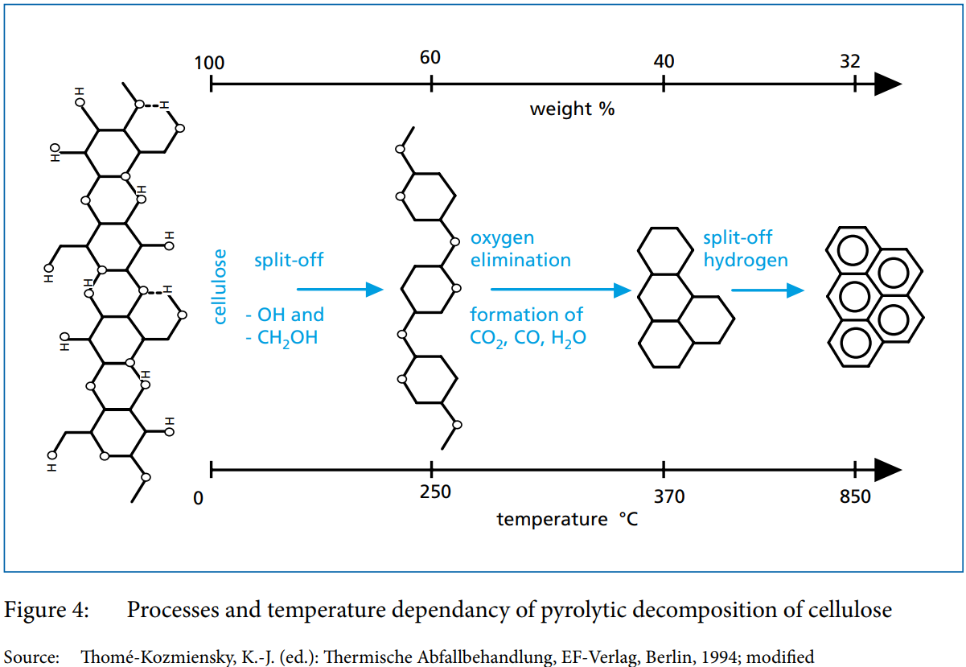

Decomposition of large hydrocarbon molecules into smaller ones during pyrolysis
Oxygen
elimination
carbonization
Split-off

Slide 16
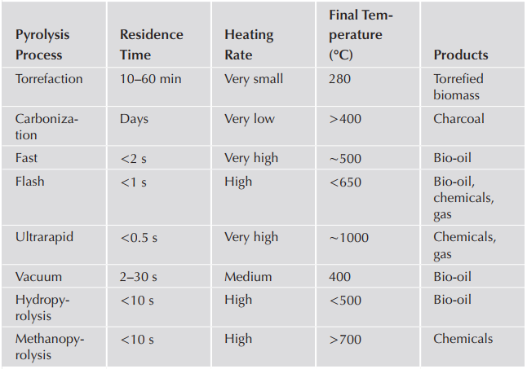
Characteristics of some thermal decomposition processes
Mohan, D., Pittman Jr., C.U., Steele, P.H., 2003. Pyrolysis of Wood/Biomass for Bio- oil: A Critical Review. Energy Fuels 20, 848–889.

Slide 17
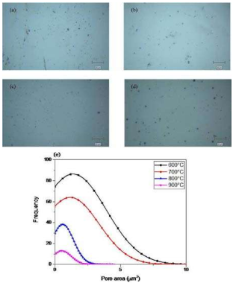
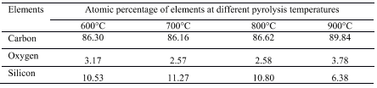
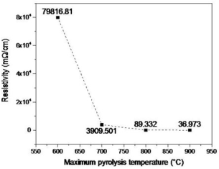
Effect of maximum pyrolysis temperature

Slide 18
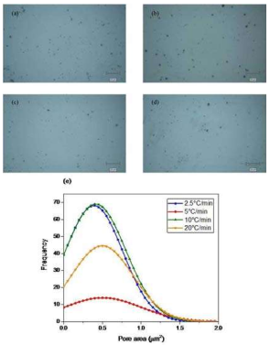
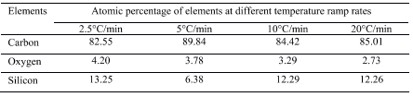
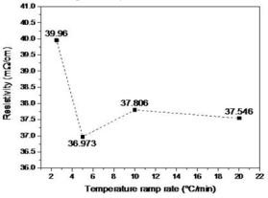
Effect of temperature ramp rate

Slide 19
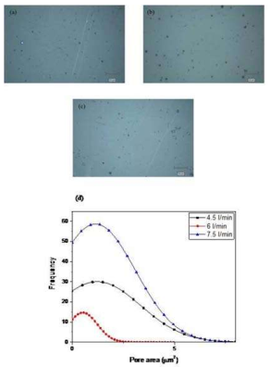
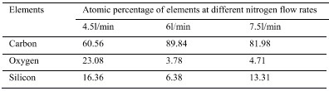
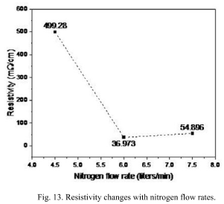
Effect of nitrogen flow rate

Slide 20
Experiment : characterization
Pore size distribution
Optical images of the surface by confocal microscopy
Resistivity measurements
4-point probe method
Chemical composition (quantify the elements present on the surface of the structures)
Energy-dispersive X-ray spectroscopy
Raman spectroscopy w/a 514 nm Ar laser source

Slide 21
Experiment : parameters to study
Three pyrolysis parameters
Maximum temperature
600°C, 700°C, 800°C and 900°C
Temperature ramp rate constant @ 5°C/min
Nitrogen flow rate constant @ 6l/m
Temperature ramp rate
2.5°C/min, 5°C/min, 10°C/min and 20°C/min
Maximum temperature constant @ 900°C
Nitrogen flow rate constant @ 6l/min
Nitrogen flow rate
3l/min, 4.5l/min, 6l/min and 7.5l/min
Maximum temperature constant @ 900°C
Temperature ramp rate constant @ 5°C/min

Slide 22

Photolithography: Step by step
Jae-Hwang Lee. (2015). Photolithography: Step by step - YouTube. Retrieved from https://www.youtube.com/watch?v=oBKhN4n-EGI

Slide 23
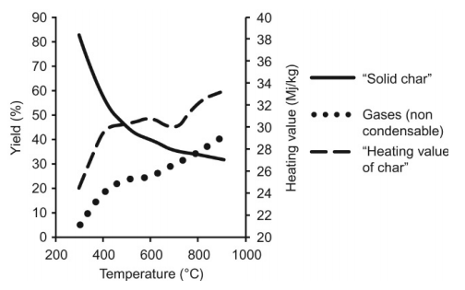
Pyrolysis
Rapid heating -> higher volatiles (more liquids)
Low temperatures -> greater amount of char; gas yield decreases
Pyrolysis of grape biomass
Basu, P. (2018). Biomass Gasification, Pyrolysis and Torrefaction - Practical Design and Theory (3rd Edition). Elsevier. Retrieved from https://app.knovel.com/hotlink/pdf/id:kt011PGVNJ/biomass-gasification/biomass-ga-historical
Notes:
Small particles -> higher liquid yield

Slide 24
References
Pramanick, B., Vazquez-Pinon, M., Torres-Castro, A., & Martinez-Chapaa, S. O. (2018). Effect of pyrolysis process parameters on electrical, physical, chemical and electro-chemical properties of SU-8-derived carbon structures fabricated using the C-MEMS process. Materials Today: Proceedings, 5(3), 9669–9682. https://doi.org/10.1016/J.MATPR.2017.10.153
Mohan, D., Pittman Jr., C.U., Steele, P.H., 2003. Pyrolysis of Wood/Biomass for Bio- oil: A Critical Review. Energy Fuels 20, 848–889
Ulyanov, V., Koshelev, M., Kharchuk, S., Gulevskii, V., & Timochkin, A. (2018). Study of the pyrolysis of solid organic polymers by their heating with metal melt. Petroleum Chemistry, 58(1), 68–75. https://doi.org/10.1134/S0965544118010140

